Slide 1
Project presentation Study on enhancing conversion for a Kerala based tour operator

Slide 2

Customer Journey
A customer's whole experience and interactions with a product, service, or brand are referred to as their "customer journey." From the preliminary awareness and deliberation stage through the post-purchase and advocacy stage, it covers all touchpoints and phases of the customer experience.

Slide 3
Dreaming phase
The phase of travel in which we dream about how our trip should be like
Destination Selection
The phase of trip where we select the destination based on our choice
Planning
The phase of travel where we do the necessary planning like the number of days of stay etc..
Information Search
The phase of travel where we look up more information about our destination

Slide 4
Booking
The phase of travel where we look for a suitable package for our travel
Travel
The travel !
Post Travel
The phase of travel where you compare the experience you had in the trip with your dream

Slide 5

Objectives of study
The goal of our research will be to thoroughly examine the following:
reviews of paradise holidays, including a sentiment analysis of those reviews
Why do consumers select Paradise Holidays over its rivals?
How can we increase the conversions of paradise holidays from 10% to 20%?

Slide 6

Background study
I conducted background research that will be useful to me throughout the study before I started. It largely focused on the travel industry, factors impacting tourism, Kerala tourism, how technology affects travel, etc. This section significantly helped me, by giving me a base .

Slide 7

Factors affecting tourism
Environmental factors:
The weather has an impact on tourism. Flood, intense rain, or drought can have a negative impact on tourism. It might be challenging for people to travel to and enjoy a vacation when the weather is harsh.
Economy of the country :
People are much less likely to take a vacation at that time if the nation's economy is in jeopardy. Increased unemployment is one factor that can have a significant influence on tourism.
Accessibility :
When we consider travelling, convenience is what we usually think of. Well-connected roads, railroads, and airports close by can all have a big impact on how many people visit a place. People prefer traveling to places that are easily accessible .
There has also been an increasing demand for adventure tourism in modern times

Slide 8
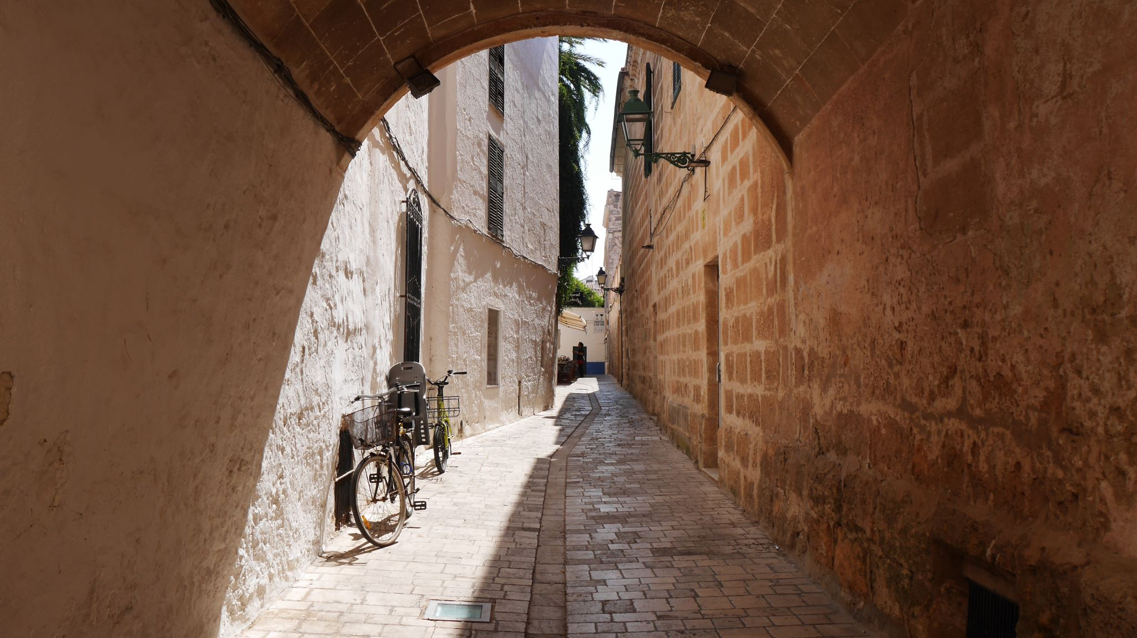
Destination :
Historic / Cultural Importance :
If the place is of historical or cultural importance , it tends to attract more tourist .
Religious Importance :
Since pilgrimage is believed to provide about inner calm, people choose to visit religiously significant locations, which makes them popular tourist destinations.
Accommodation :
Leisure travel mostly focuses on providing a respite from the demanding workplace. As a result, the place of stay is highly valued by individuals. A good hotel can have a significant impact on the area's tourism.
Other services:
A tourist site will be able to hold (retain) more visitors for a longer period of time if it has auxiliary (supplementary) services like banking and finance, Internet and telecom connectivity, hospitals, insurance, and so on

Slide 9

Technology vs Tourism
The travel business has benefited greatly from the use of technology, which has completely changed how travelers plan, reserve, enjoy, and share their experiences.
How technology can help in tourism :
Improvements in technology has helped in making the booking process much easier . The bookings of hotels , flights etc can be done with a few clicks .
With much of the data about the destination available in the internet , it makes easier for tourists to access various details , maps etc .
As the technology advances , with the help of machine learning and artificial intelligence , we can provide customised and personalised packages for customers , allowing flexibility in the system and promoting tourism
Technology also promotes sustainable tourism practices . It helps in environmental protection and thereby energy conservation too

Slide 10

Marketing using technology
Social media marketing :
Social media is widely used in the generation we currently belong to. Utilizing push notifications and other eye-catching message pop-ups on social media can significantly affect the growth of tourism.
Personalization :
Using their previous activities likes web searches , we can provide a personalized and better options for their desired destination
Online reviews :
Online reviews have a big influence on shoppers. People are always interested in learning about the experience, so hearing from someone who has had it gives them hope that they may match their ideal with the service offered.
Search engine optimization
We can use virtual reality and augumented reality to provide a better user experience

Slide 11

Approach to the problem
I'd want to categorise our issue broadly in order to have an in-depth analysis of it:
Quantitative analysis : I would like to compare the data gathered from paradise holidays over the previous six months under this division. The information includes both website analytics data and customer service booking data (without the customers' personal information).
Qualitative analysis : In this division, the research is focused on customers' reviews or comments regarding the service they received. We shall evaluate the passengers' feelings both before and after the trip by assessing their sentiments.

Slide 12

Quantitative analysis
1. It is the analysis of the quantifiable data that helps researchers arrive at their conclusion .
2. Quantative analysis can help us predict the future sales of our product by looking to the sales of past few months .
3. Data about websites from Google Analytics and customer service booking are used in my study. Additionally, we categorize them depending on the destination, the number of searches, and the number of searches based on packages in order to better understand customer behavior.

Slide 13

Qualitative Analysis
The type of processing , gathering of qualitative data that gives us insights about the customers
Qualitative analysis helps us analysis the text , images , audio etc and find a general pattern or theme
Majorly focuses on strengthening the understanding between the service provider and user

Slide 14

Customer Journey: Point of contacts
Let's go into more detail about the planning and booking step of the customer experience that was previously mentioned. Planning is the phase in which a consumer considers picking paradise holidays, and booking is the phase in which they actually make that selection. Therefore, only these phases have any bearing on the conversion rate.
Point of contact : point of contact is the where the company representatives who work with the customers provide them the necessary details of the company and the service they provide . This has a lot of influence on the customers and helps them decide .

Slide 15
Planning Phase
They scan the internet and social media for a good service provider during this phase. If they are still interested, they can now submit a website inquiry. The conversation about the trip continues in a subsequent call. If they show additional interest, a customized itinerary is created and provided to the clients. The required adjustments are done upon request. The customers are now informed of every aspect of the journey. At this pivotal moment, they must decide whether to take the occur or not.
Booking
Customers only book the package if they are truly satisfied with the aforementioned services.

Slide 16

User persona
The target consumer's profile is known as a customer persona. When discussing branding, the idea of the client persona is crucial.
Branding is the process of giving your goods or services a distinctive identity or mark.
We can attempt to create a consumer profile from the quantitative research that has been done, which will be very helpful for addressing our issue and determining the best course of action.
According to the research, most of our customers are married couples or family men between the ages of 25 and 40 who are doing well financially and would like to take a luxurious vacation. Most of them are outsiders, from places like Maharashtra and Karnataka. They may have few contacts in Kerala because they are outsiders, therefore they would only learn about Kerala through us. So, this will serve as the user persona's foundation.
For instance, 35-year-old Ravi Sharma from Pune, Maharashtra, wants to travel for 4 days with his family to Munnar, Alappey, and Cochin.
It will be simple for us to offer a benefit rather than a feature now that we have a basic idea of who our clients are.

Slide 17

Interaction with staff
I got the opportunity to visit the office and work with them . They provided me with a very welcoming and helpful environment, and I really appreciate it. Based on staff interviews I conducted , I arrived at the following conclusion :
Customers are really satisfied with their services, as there aren't many complaints.
Packages are customized based on the information provided by the customer.
Customer service division claimed that they solicit comments from customers before, during, and after the journey.
While interacting with the staff, I was able to learn more about customer profiles, which helped me develop their user persona.

Slide 18
Analysis of interviews
In the month of May, Paradise Vacations interviewed clients. I also performed a few interviews last week, and I have created an analysis based on the interviews.
Sample size : 135
Interviews taken by paradise : 100
Interviews taken by me : 35

Slide 19
How did they come to know about paradise : 78.7% people said they got to know about paradise holidays from google
Source of awareness
 | Frequency | Percent
Google | 107 | 78.7
Recommendation | 15 | 11.0
Instagram | 7 | 5.1
Past customer | 3 | 2.2
Others | 4 | 2.9
Total | 136 | 100.0

Slide 20
Decision Influence
 |  | Frequency | Percent
Valid | Review | 35 | 25.7
 | Package | 27 | 19.9
 | Service | 45 | 33.1
 | Brand | 3 | 2.2
 | Website | 7 | 5.1
 | Recommendation | 3 | 2.2
 | Award | 3 | 2.2
 | NA | 13 | 9.6
 | Total | 136 | 100.0
What made customers choose Paradise Holidays ?
Reviews influenced 25.7% of customers to choose paradise holidays.

Slide 21
Analysis of Interviews
What did they like paradise holidays ?
Product Appeal
Answers customers gave | Frequency | Percent
Service | 42 | 30.9
Activities | 26 | 19.1
Reviews | 2 | 1.5
Website | 1 | 0.7
Hotel | 9 | 6.6
Package | 17 | 12.5
Others | 39 | 28.7
Total | 136 | 100.0
Customers indicated in 30.9% of responses that they truly enjoyed the services offered by paradise holidays.

Slide 22
Analysis of Interviews
Does reviews or recommendations influence the customers?
80.1% of customers claim that reviews influenced their decision.
Reviews
Answer customers gave | Frequency | Percent
No | 26 | 19.1
Yes | 109 | 80.1
Didn’t Answer | 1 | 0.7
Total | 136 | 100.0

Slide 23
Analysis of Interviews
Pricing Effect
Answer customers gave | Frequency | Percent
No | 35 | 25.7
Yes | 101 | 74.3
Total | 136 | 100.0
Did the price of the package influence them in making their decision
The cost of the package, according to 74.3% of clients, did affect their decision.

Slide 24
Analysis of interviews
Would they book another trip on paradise holidays ?
64% of respondents said they would undoubtedly book another trip with paradise holidays
Future Booking
Answer customers gave | Frequency | Percent
No | 19 | 14.0
Yes | 87 | 64.0
Maybe | 16 | 11.8
NA | 14 | 10.3
Total | 136 | 100.0

Slide 25
Insights
Customers are extremely happy as evidenced by the future bookings table, where 64% of customers want to book package again.
The reason why they chose Paradise over its competitor may be understood from the product appeal table: they were most attracted to the company's services .
The source of awareness table makes it abundantly clear that the majority of individuals learned about paradise holidays through the internet or Google, thus we should work to promote that aspect to enhance conversions.
80% of consumers read reviews and recommendations before hiring someone, therefore it is important to develop a network through those channels as well.

Slide 26
Comparing product appeal and future booking
 |  | Booking |  | Total
 |  | No | Yes
Product Appeal | Service | 9 | 33 | 42
 | Activities | 5 | 21 | 26
 | Reviews | 1 | 1 | 2
 | Website | 0 | 1 | 1
 | Hotel | 0 | 9 | 9
 | Package | 4 | 13 | 17
 | Others | 14 | 25 | 39
Total |  | 33 | 103 | 136
Here, you can see that 33 of the 136 customers who said that they would book another trip with Paradise Vacations mentioned that their favourite aspect of the company was their service.

Slide 27
Comparing pricing effect and future booking
 |  | Booking |  | Total
 |  | No | Yes
Pricing effect | No | 13 | 22 | 35
 | Yes | 20 | 81 | 101
Total |  | 33 | 103 | 136
This is a statistically significant result, and after running the test, we only received a 3% error, which means that the correlation between booking and pricing effect is 97%.
We can see that 81 out of 103 respondents indicated that the pricing impact did matter, and that they would undoubtedly plan another trip in the future.
 | Value | df | Asymptotic Significance (2-sided)
Pearson Chi-Square | 4.253ª | 1 | 0.039
Continuity Correction^{b} | 3.362 | 1 | 0.067
Likelihood Ratio | 4.014 | 1 | 0.045
Fisher's Exact Test
Linear-by-Linear Association | 4.222 | 1 | 0.040
N of Valid Cases | 136

Slide 28
Comparing Deals and promotions and future booking
 |  | Booking |  | Total
 |  | No | Yes
Deals and Promotions | No | 32 | 92 | 124
 | Yes | 0 | 10 | 10
 | NA | 1 | 1 | 2
Total |  | 33 | 103 | 136
92 of the 103 people who replied yes stated that we made our reservations previously , not because paradise offered us a nice price or discount.

Slide 29
Comparing specific arrangements and future booking
Without any specific arrangements being made on our most recent trip, 62 out of 103 respondents said they would still be eager to book a package in the future.
 |  | Booking |  | Total
 |  | No | Yes
Specific Arrangements | No | 19 | 62 | 81
 | Yes | 12 | 40 | 52
 | NA | 2 | 1 | 3
Total |  | 33 | 103 | 136

Slide 30

Customer feedback
Most of them complained about the houseboats' accommodations.
Additionally, they did not like how the driver was acting.
One of them stated: "We are so exhausted from travelling that we are not in the mood to call Paradise Holidays and address our concerns. It will be wonderful if they made a routine check on us, perhaps they could resolve the lodging issues at the very least."

Slide 31
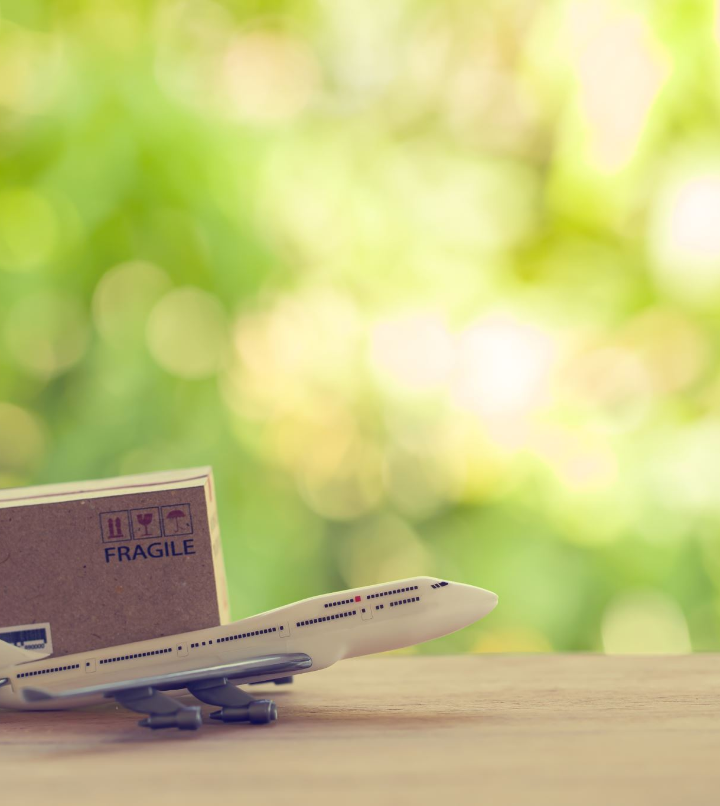
Case study : Customer experience post travel + pre travel
Date of travel : 28th June
Pre-travel
“The booking process was quite easy, and the personnel was very helpful. The team was really attentive and good at connecting with us, so we were able to customise the package.”
Post Travel :
“Our travel was for 4 days , we really enjoyed the stay , we are satisfied with services provided by paradise holidays , looking forward to our next tour with paradise holidays.”

Slide 32
Discussions / Implications

Slide 33

Automation: Does people prefer it or not
Automation is use of technology to minimize the human touch , that’s process of reducing the point of contacts .
So, looking into the pros of automation :
1. Cost saving
2. Can handle a large workload and complete efficiently
3. All the data handled will be accurate
On the other hand, there is may be many reasons why people don’t prefer it .

Slide 34
So, from the point of view of a customer using automation in paradise holidays website :
Most people who make reservations are not comfortable with technology and prefer more human interaction since they feel it is more reliable.
More human touch instils a sense of belief in them that they are really taken care of , or they are getting much attention from the service provider .
Perhaps we should use technology properly. The use of technology in direct bookings these days

Slide 35
Sales vs Marketing
Marketing is the process of making people interested in your product through various strategies like pricing, packaging, positioning (creating a perception), placement and promotion.
Sales is the process of selling goods and services. It involves convincing potential customers to buy from your company.
The convincing can be through various means such as explaining your product's benefits, offering discounts or making your product more attractive than that of your competitors. Some common sales generation methods include making cold calls, holding one-on-one meeting with business leads etc .
It's all about marketing up until the point where a customer submits an inquiry, but once they receive a call , the focus shifts to sales, which is what ultimately persuades them to purchase our goods.

Slide 36
Experience attribute vs search attribute
Searching through internet
Call back from sales executive
Going for the trip
Experience attribute
Search and experience attribute
Search
attribute
Customers can quickly examine the search attribute's attributes before making a purchase. Before making a purchase, it is possible to compare the cost of a hotel room and the flight itinerary.
On the other hand, the experience attribute can only be assessed after we use it or after we buy it.
Here ,there are three primary steps: searching the internet, getting a call from our sales representative, and making the journey there.
If I want to classify the process it will be as :

Slide 37

References
1. Christou, P., Hadjielias, E., Simillidou, A., & Kvasova, O. (2023). The use of intelligent automation as a form of digital transformation in tourism: Towards a hybrid experiential offering. Journal of Business Research, 155, 113415.
2. Tussyadiah, I. (2020). A review of research into automation in tourism: Launching the Annals of Tourism Research Curated Collection on Artificial Intelligence and Robotics in Tourism. Annals of Tourism Research, 81, 102883.
3. https://in.indeed.com/career-advice/finding-a-job/difference-between-sales-and-marketing#:~:text=Marketing%20focuses%20on%20moving%20the,the%20needs%20of%20the%20market.
4. http://www.simplynotes.in/e-notes/mbabba/service-marketing-brand-management/searchexperience-and-credence-attributes/

Slide 38

Learning outcomes
The project was crucial in helping me develop my analytical and critical thinking skills.
I was able to pay great attention to a company's operations, teamwork, and other principles.
It has significantly improved my ability to solve problems.

Slide 39

Thank you

